Slide 1
SKENARIO
Scipy

Slide 2
TIM DATA SCIENCE
PERLU DIBUAT MODEL
Model untuk prediksi calon customer untuk program marketing selanjutnya
Terima report dari tim marketing
Dari report tersebut didaptkan masih gagal (88% tdk beli deposito)
Evaluasi
Tambahan :
Concern tim marketing di cost campaign
[PENTING] model digunakan sebelum melakukan campaign/program marketing
Kolom di dataset model yang dipakai adalah KOLOM YG BISA DIDAPATKAN Sebelum melakukan Campaign
!! INGAT !!
Calon customer yang di approach adalah nasabah bank tersebut

Slide 3
Analisis dilakukan di waktu jeda antar program
Mengacu pada jumlah minimal rekening nasabah premium
Gas masukin ke list calon customer
Model
Proba YA > 0.6
Data baru
!! INGAT !!
patokan di 500 jt rupiah/ 30,000 euro
Rekening >= patokan (SABI)
Rekening < Patokan (tidak sabi)
Sabi
0.6 >=Proba Ya >= 0.3
Lihat isi rekeningnya sabi ga
Tidak Sabi
Proba Ya < 0.3
JANGAN masukin ke list calon customer

Slide 4
Precision VS Recall

Slide 5
Precision diutamakan
Menghindari kerugian Cost Ketika Prediksi = YA tapi Aktual = TIDAK
Mengacu pada concern tim marketing
Campaign jadi lebih tepat sasaran
RESIKO
Recall kecil ➔ FN Tinggi → banyak yang prediksi = TIDAK tapi aktual = YA. → Potensial customer YA banyak yang menghilang

Slide 6
Mengatasi Resiko
Check orang-orang yang Probabilitas Ya nya di antara 0.3 – 0.6 berdasarkan Jumlah rekeningnya.

Slide 7
Urutan PPT
Tunjukin data set & casenya
Skenario
Business problem dan goals
EDA
Modelling
Simulasi
Conclusion

Slide 8
Dataset & Case
Masukin link Kaggle dan deskripsi case tersebut
Deskripsi features (sekalian tunjukin yng numerical dan categorical)

Slide 9
Skenario
Skenario Businesss (fokuskan pada si concern tim marketing dalam menekan biaya/cost)

Slide 10
Business problem dan goals
rendahnya tingkat keberhasilan marketing campaign bank XYZ saat ini
Biaya yang dikeluarkan untuk marketing campaign juga cukup besarrrr
Dibutuhkan cara agar supaya bisa memfilter nasabah yang berpotensi dan yang tidak
GOALS
Memprediksi nasabah bank yang mungkin akan mengambil dposit atau tidak untk campaign berikutnya berdasrkan model dari yang sudah terjadi dengan menggunakan Machine Learning
Memberikan simulasi penurunan cost jika menggunakan Machine learningggggg

Slide 11
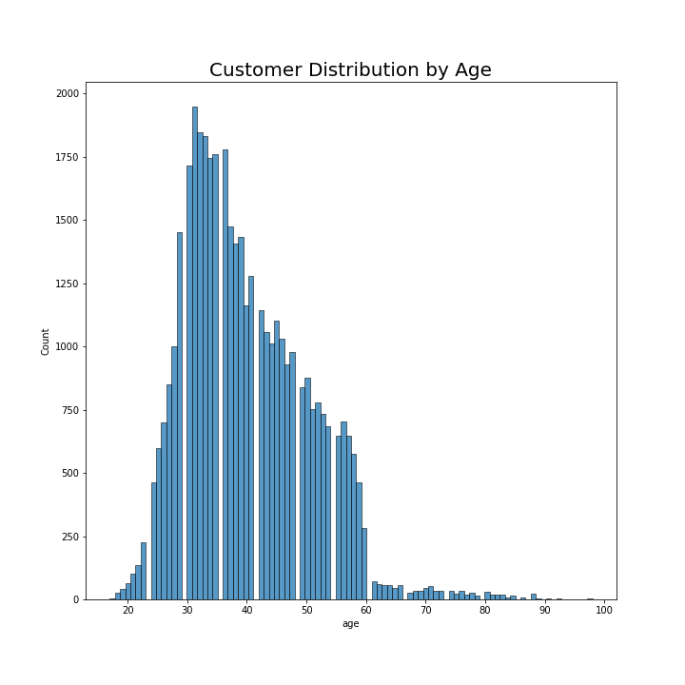
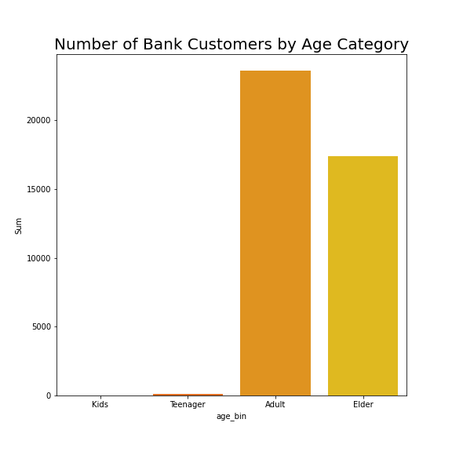
EDA - Univariate
Most customers were 25 to 60 years old
There is little to none customers in kids and teenager group

Slide 12
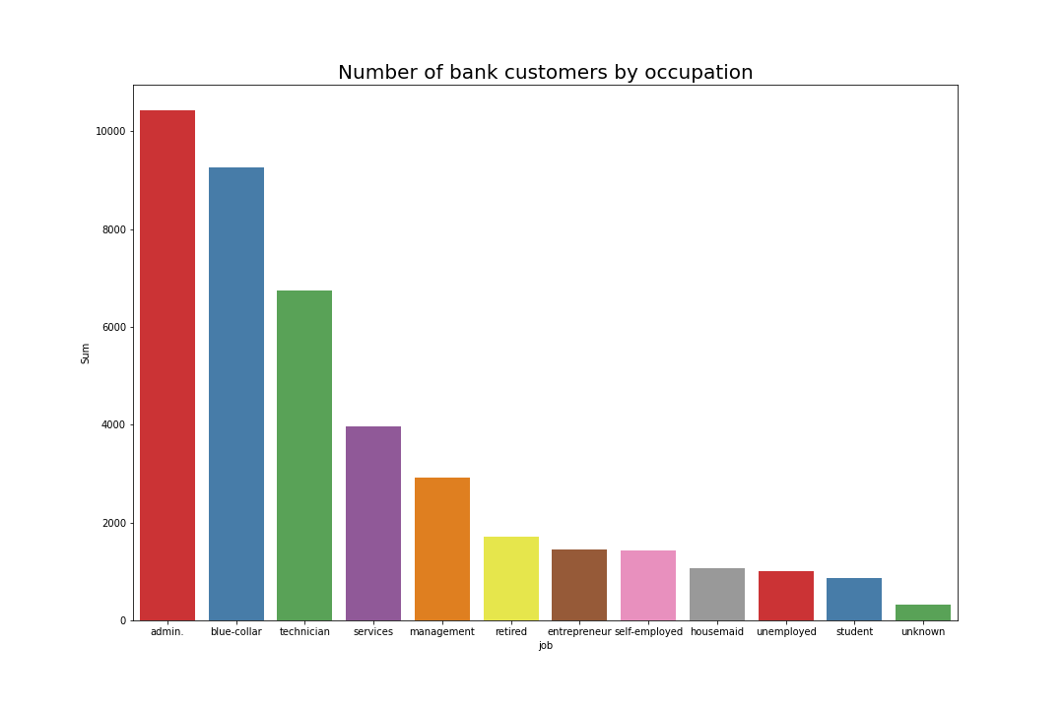
EDA – Univariate (2)
Most customers are working as admin, blue-collar, and technician

Slide 13
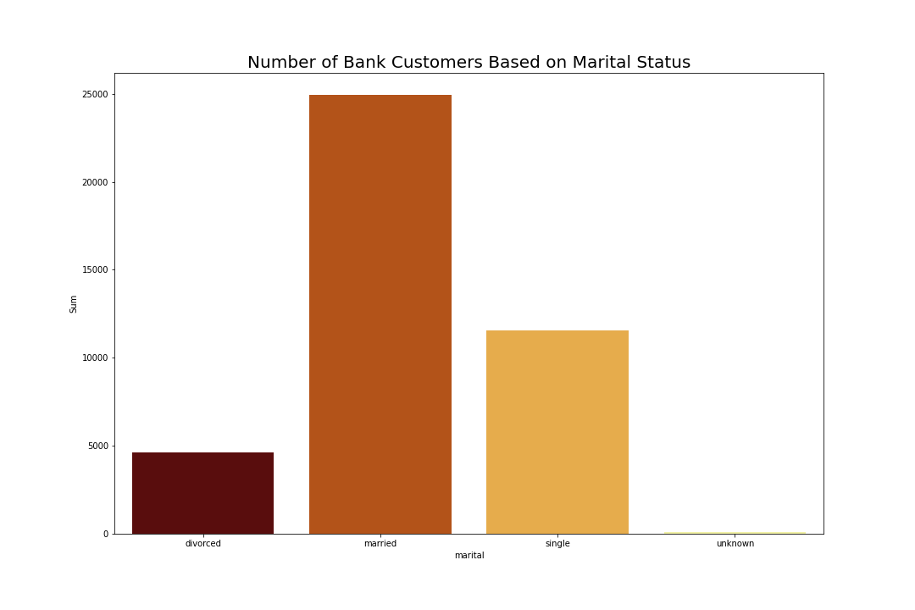
EDA – Univariate (3)
Most customers are married

Slide 14
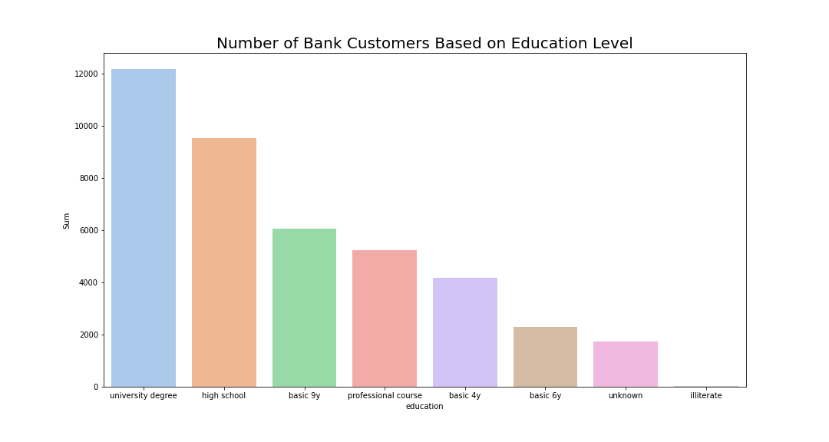
EDA – Univariate (4)
Most customers have university degree and high school education

Slide 15
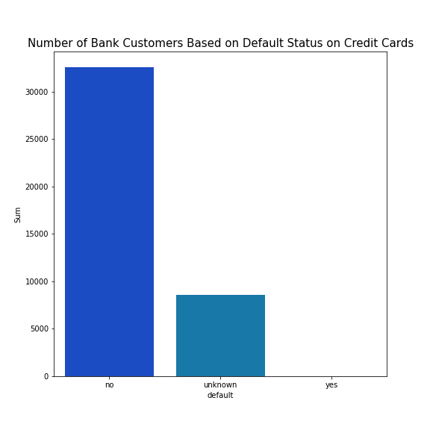
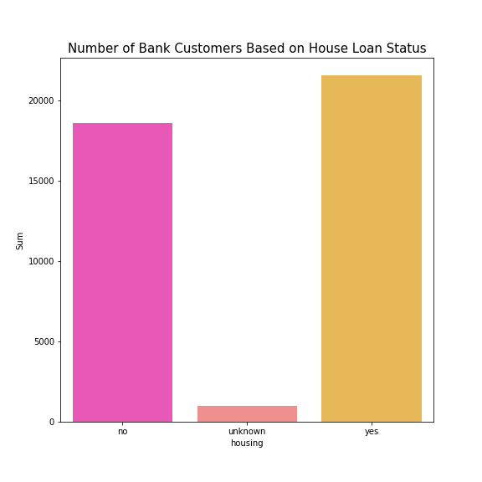
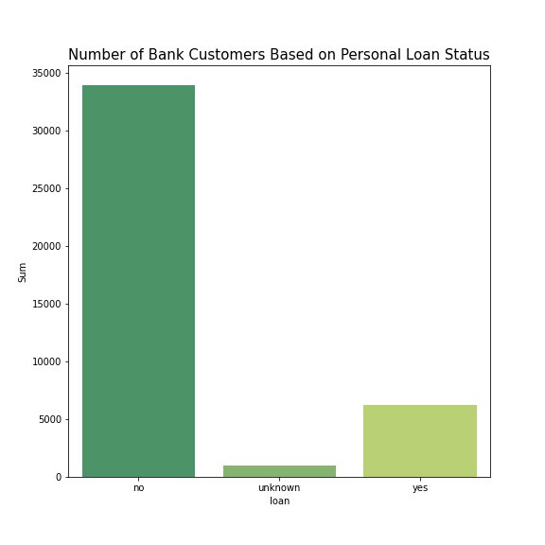
EDA – Univariate (5)
Most customers are not credit card default and has no personal loan
More than half of the customers have housing loan

Slide 16
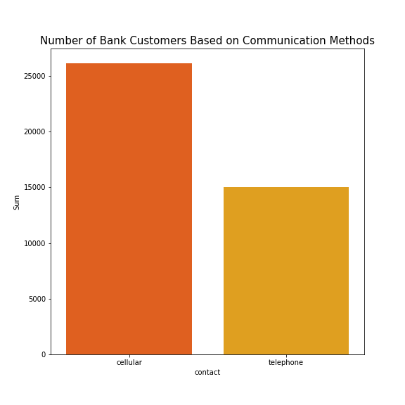
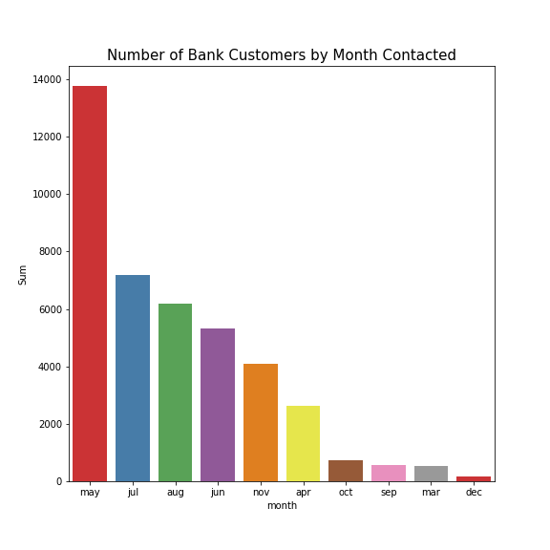
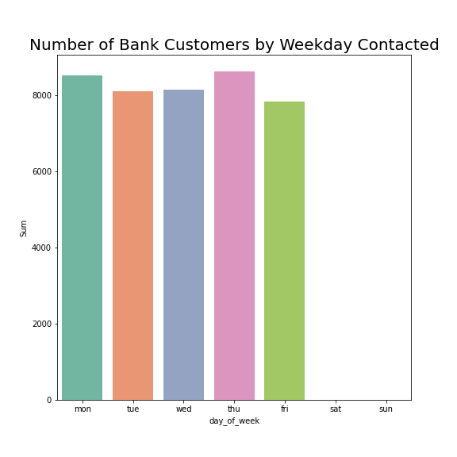
EDA – Univariate (6)
Most customers were contacted through their mobile phone
Most customers were contacted in May and all of them were contacted at weekdays

Slide 17
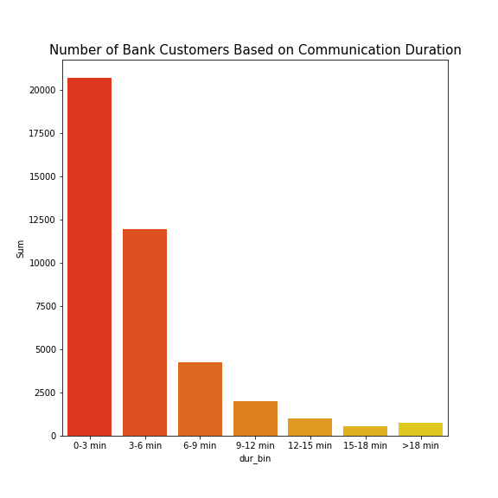
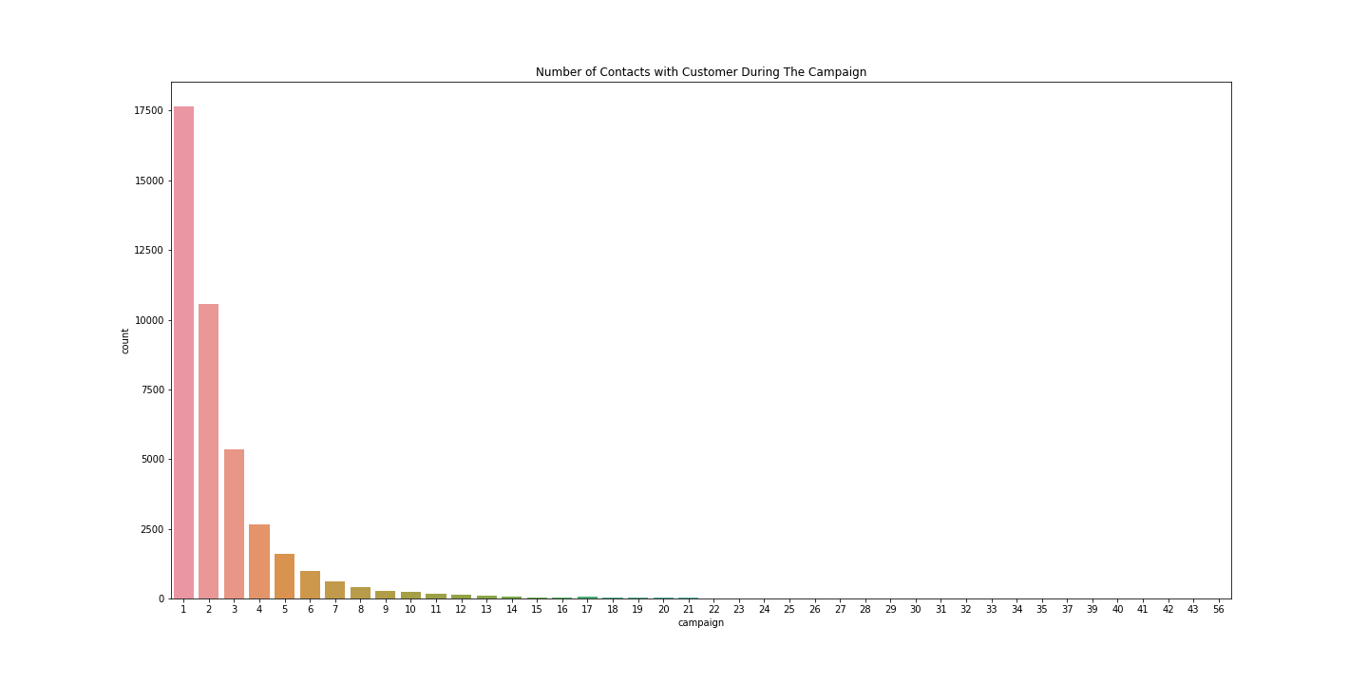
EDA – Univariate (6)
Most call durations are 0-3 mins and 3-6 mins
Most customers only contacted between 1 to 3 times during the campaign

Slide 18
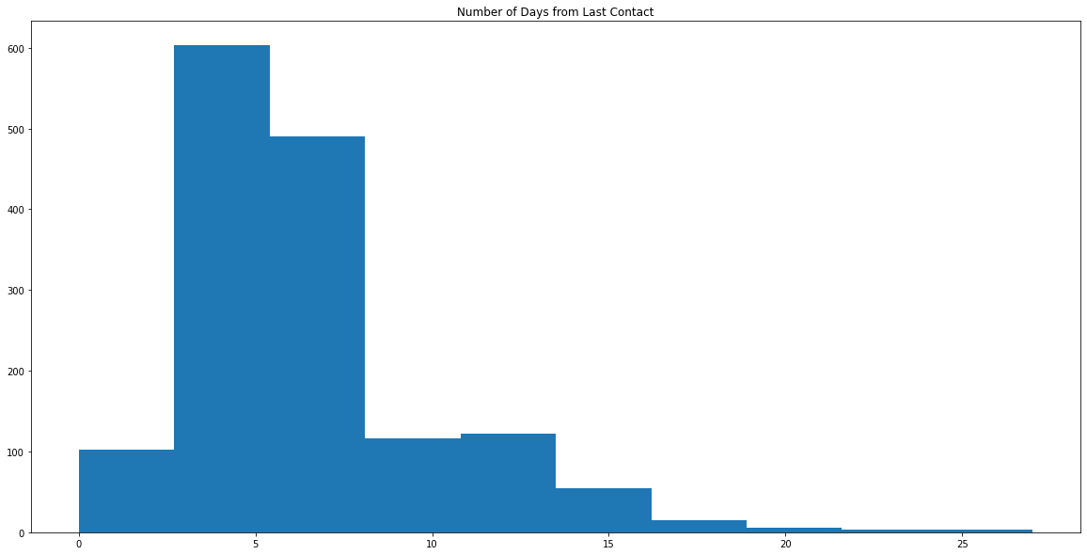
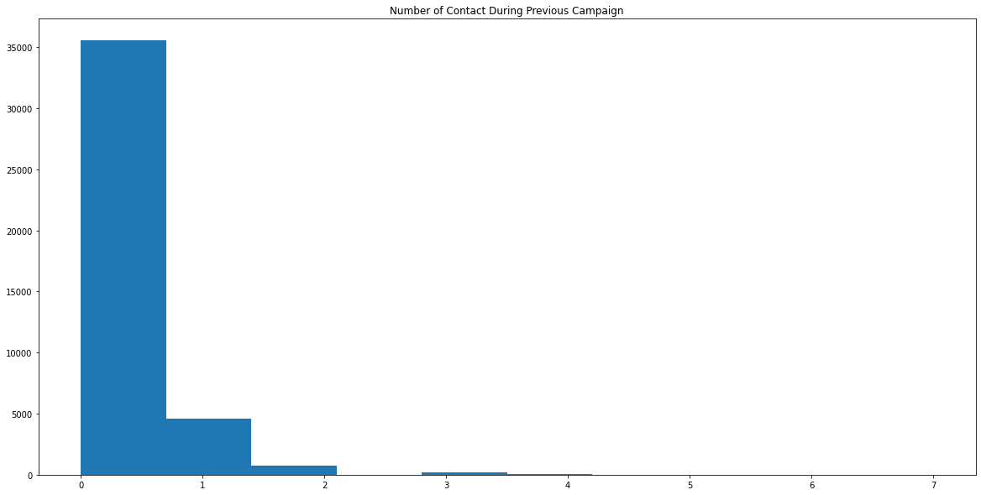
EDA – Univariate (7)
Most call customers are contacted again in 10 days
Most customers only contacted between 1 to 2 times during the previous campaign

Slide 19
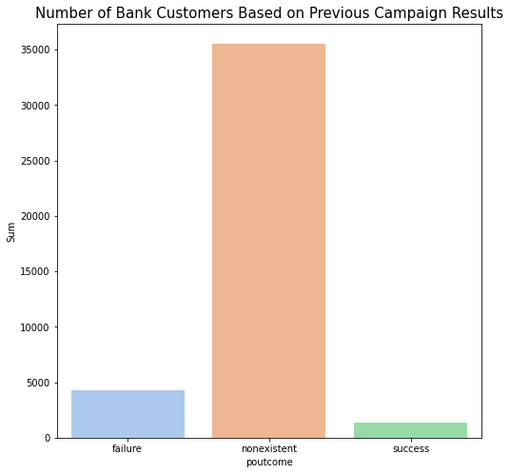
EDA – Univariate (8)
Most customers were not included in previous campaign and have nonexistent results

Slide 20
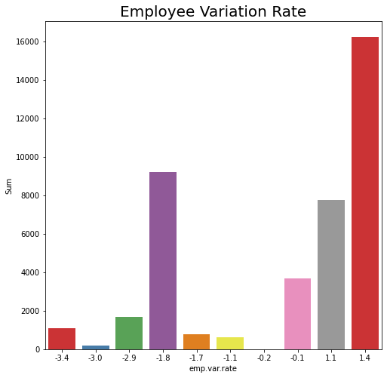
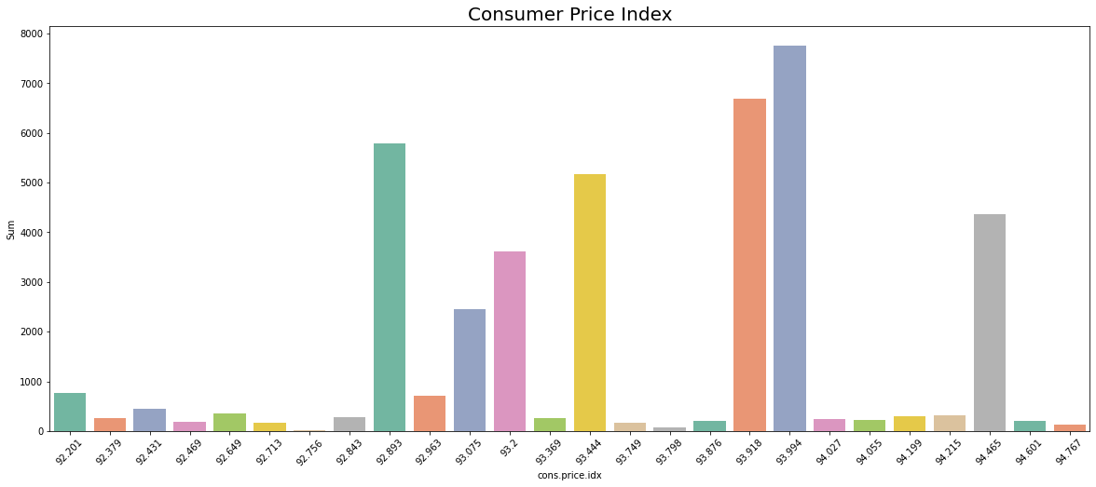
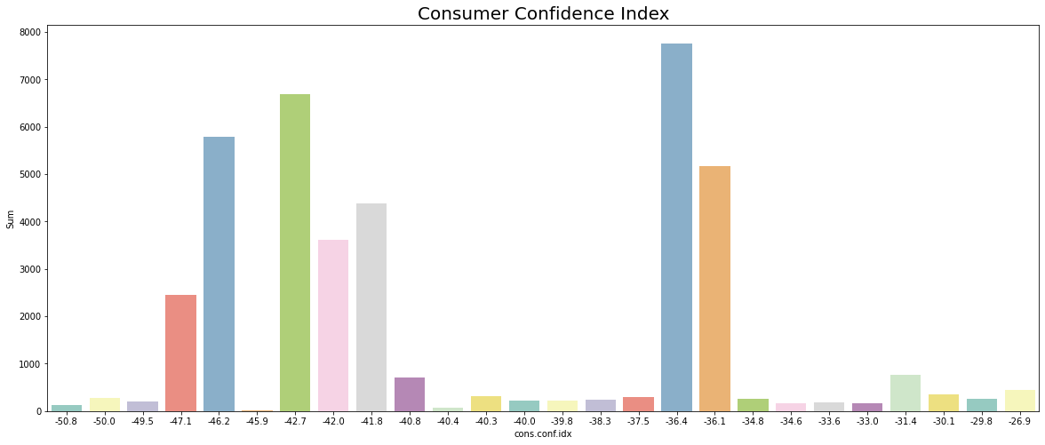
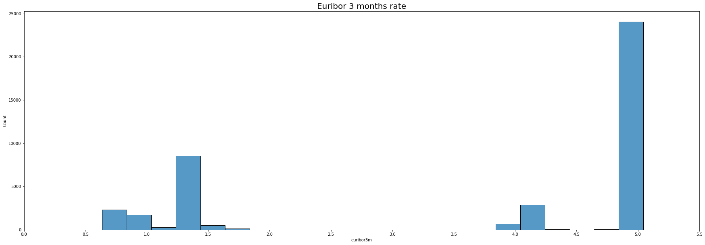
EDA – Univariate (9)

Slide 21
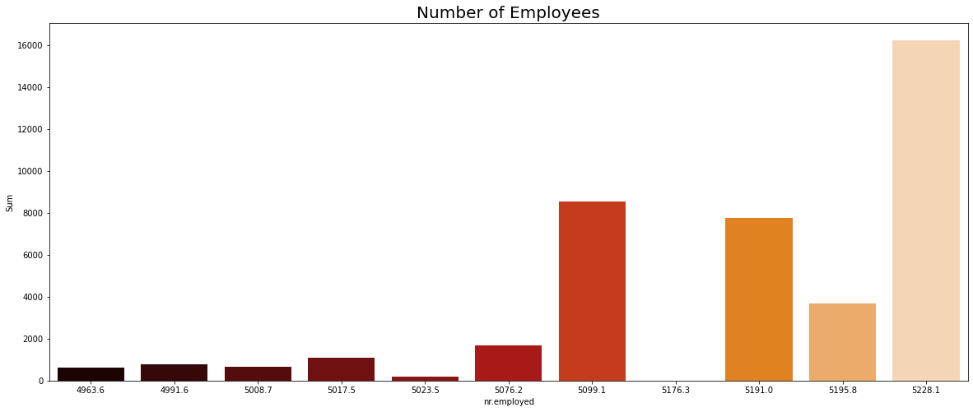
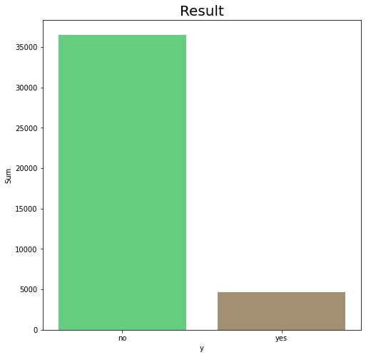
EDA – Univariate (10)
Most call customers were contacted when number of employees were high
Most didn’t subscribe to term deposit offered

Slide 22
Modelling
Tunjukkan table Perbandingan precision
Pk model apa aja
Kesimpulan
Grafik predict proba

Slide 23
Simulasi
Tunjukkan asumsi yang dipakai
Perhitungan
Kesimpulan (cost berkurang brp)

Slide 24
Conclusion
Menjawab Business Goalss

